Slide 1
Machine Learning and Image Processing using MATLAB
By
Sourabh Shanbhogue

Slide 2
Contents
Introduction to the Company
Training and Work done
Project
References
02

Slide 3


Introduction To The Company
CoreEL Technologies (I) Pvt Ltd, Bangalore.
Customer Application Specific Product and Solutions (CASPS) company.
Sandeepani - School of Embedded System Design
ATP for Xilinix and MentorGraphics

Slide 4
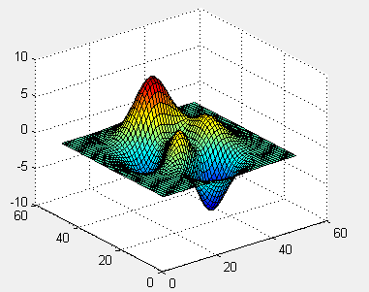
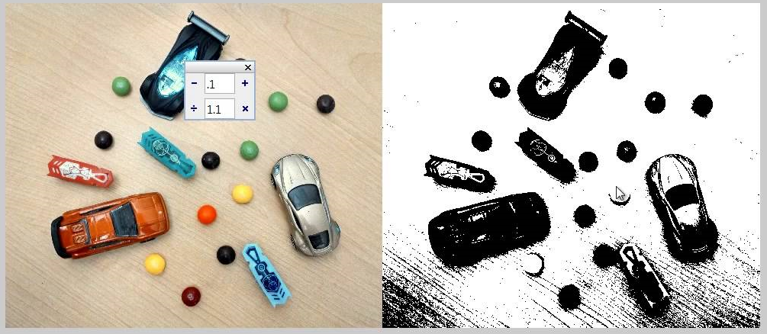
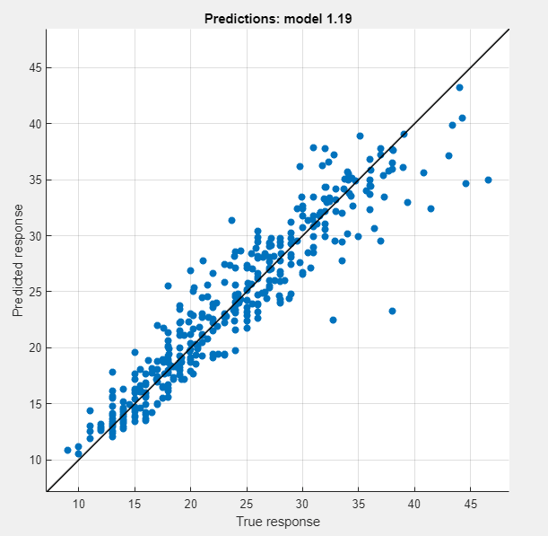
Training and Work Done
MATLAB UI
Visualization Tools
Preprocessing
Segmentation
Curve Fitting
Regression Models
04

Slide 5
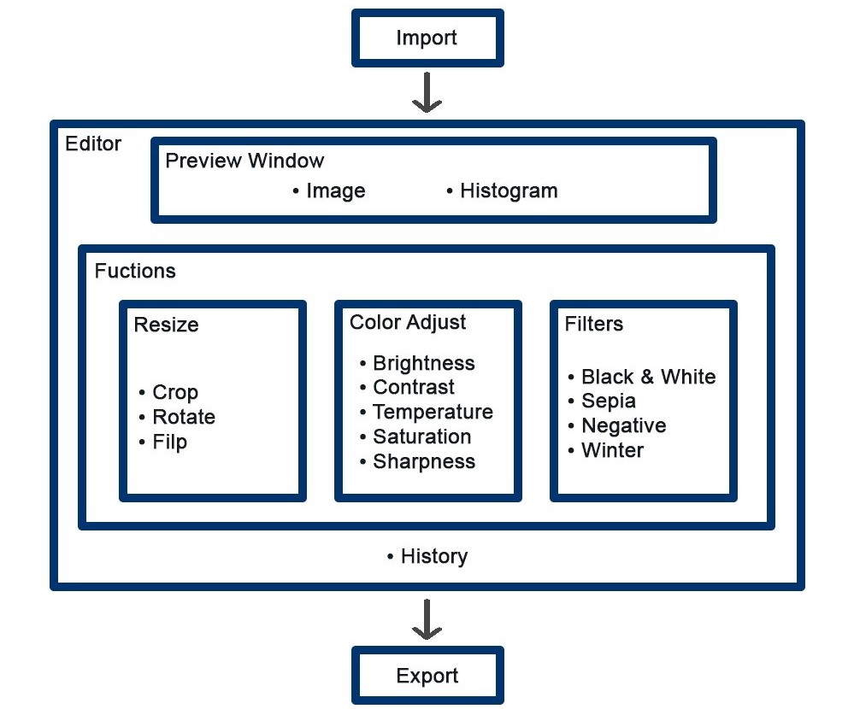
Project
Photo Editor - Preprocessing of Images

Slide 6
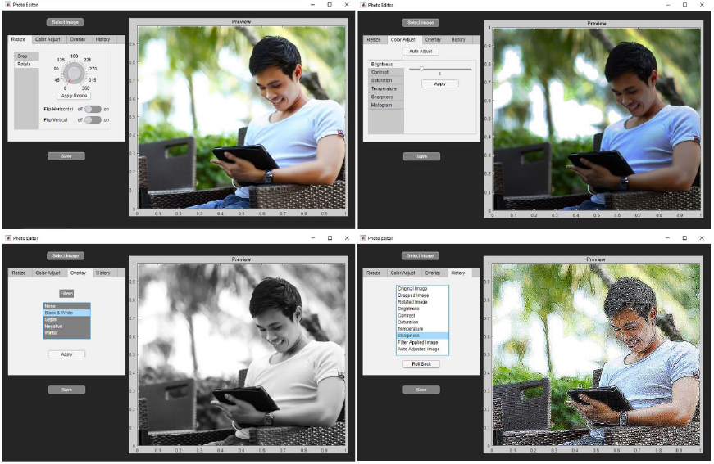
Project

Slide 7
References
[1] "MATLAB Onramp", Mathworks.com, 2021. [Online].
Available:https://www.mathworks.com/learn/tutorials/matlab-onramp.html.
[2] "Image Processing with MATLAB", In.mathworks.com, 2021.
[Online].Available:https://in.mathworks.com/learn/online-courses/image-processing-with-matlab.html.
[3] "Machine Learning Onramp", In.mathworks.com, 2021.
[Online].Available:https://in.mathworks.com/learn/tutorials/machine-learning-onramp.html.
07

